Slide 1
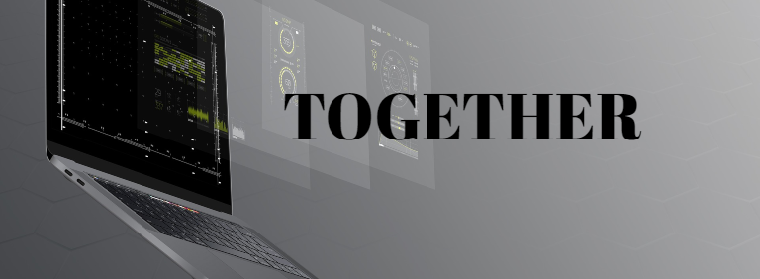
Generic Smartphone Game Controller
Bachelor Thesis
Flückiger Quentin
Notes:
Welcome to presentation of bachelor thesis.
The topic I chose is Generic ….
And I will start this presentation with a little story.

Slide 2
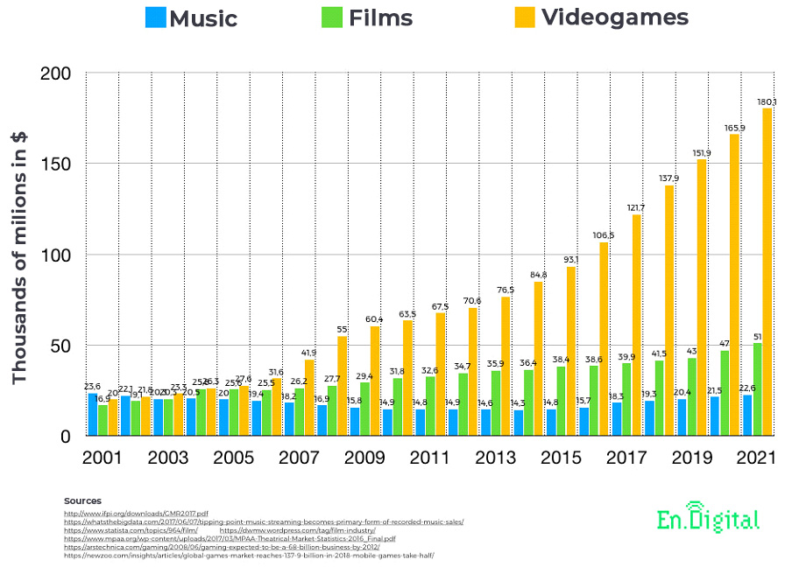
Revenue comparison
Notes:
Nowadays the gaming industry is very lucrative and has a huge part of the market in digital entertainement.
As you can see on this chart comparing Music, Movies (TV-Show not included) and videogames.

Slide 3
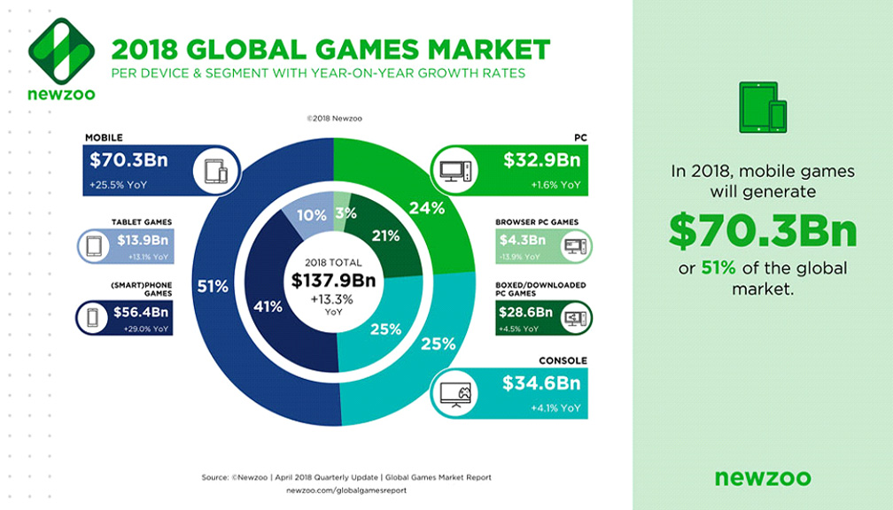
Device based comparison
Notes:
And if we look more in detail the income generated by the gaming market we can see that a solid 50% of it comes from mobile games.

Slide 4
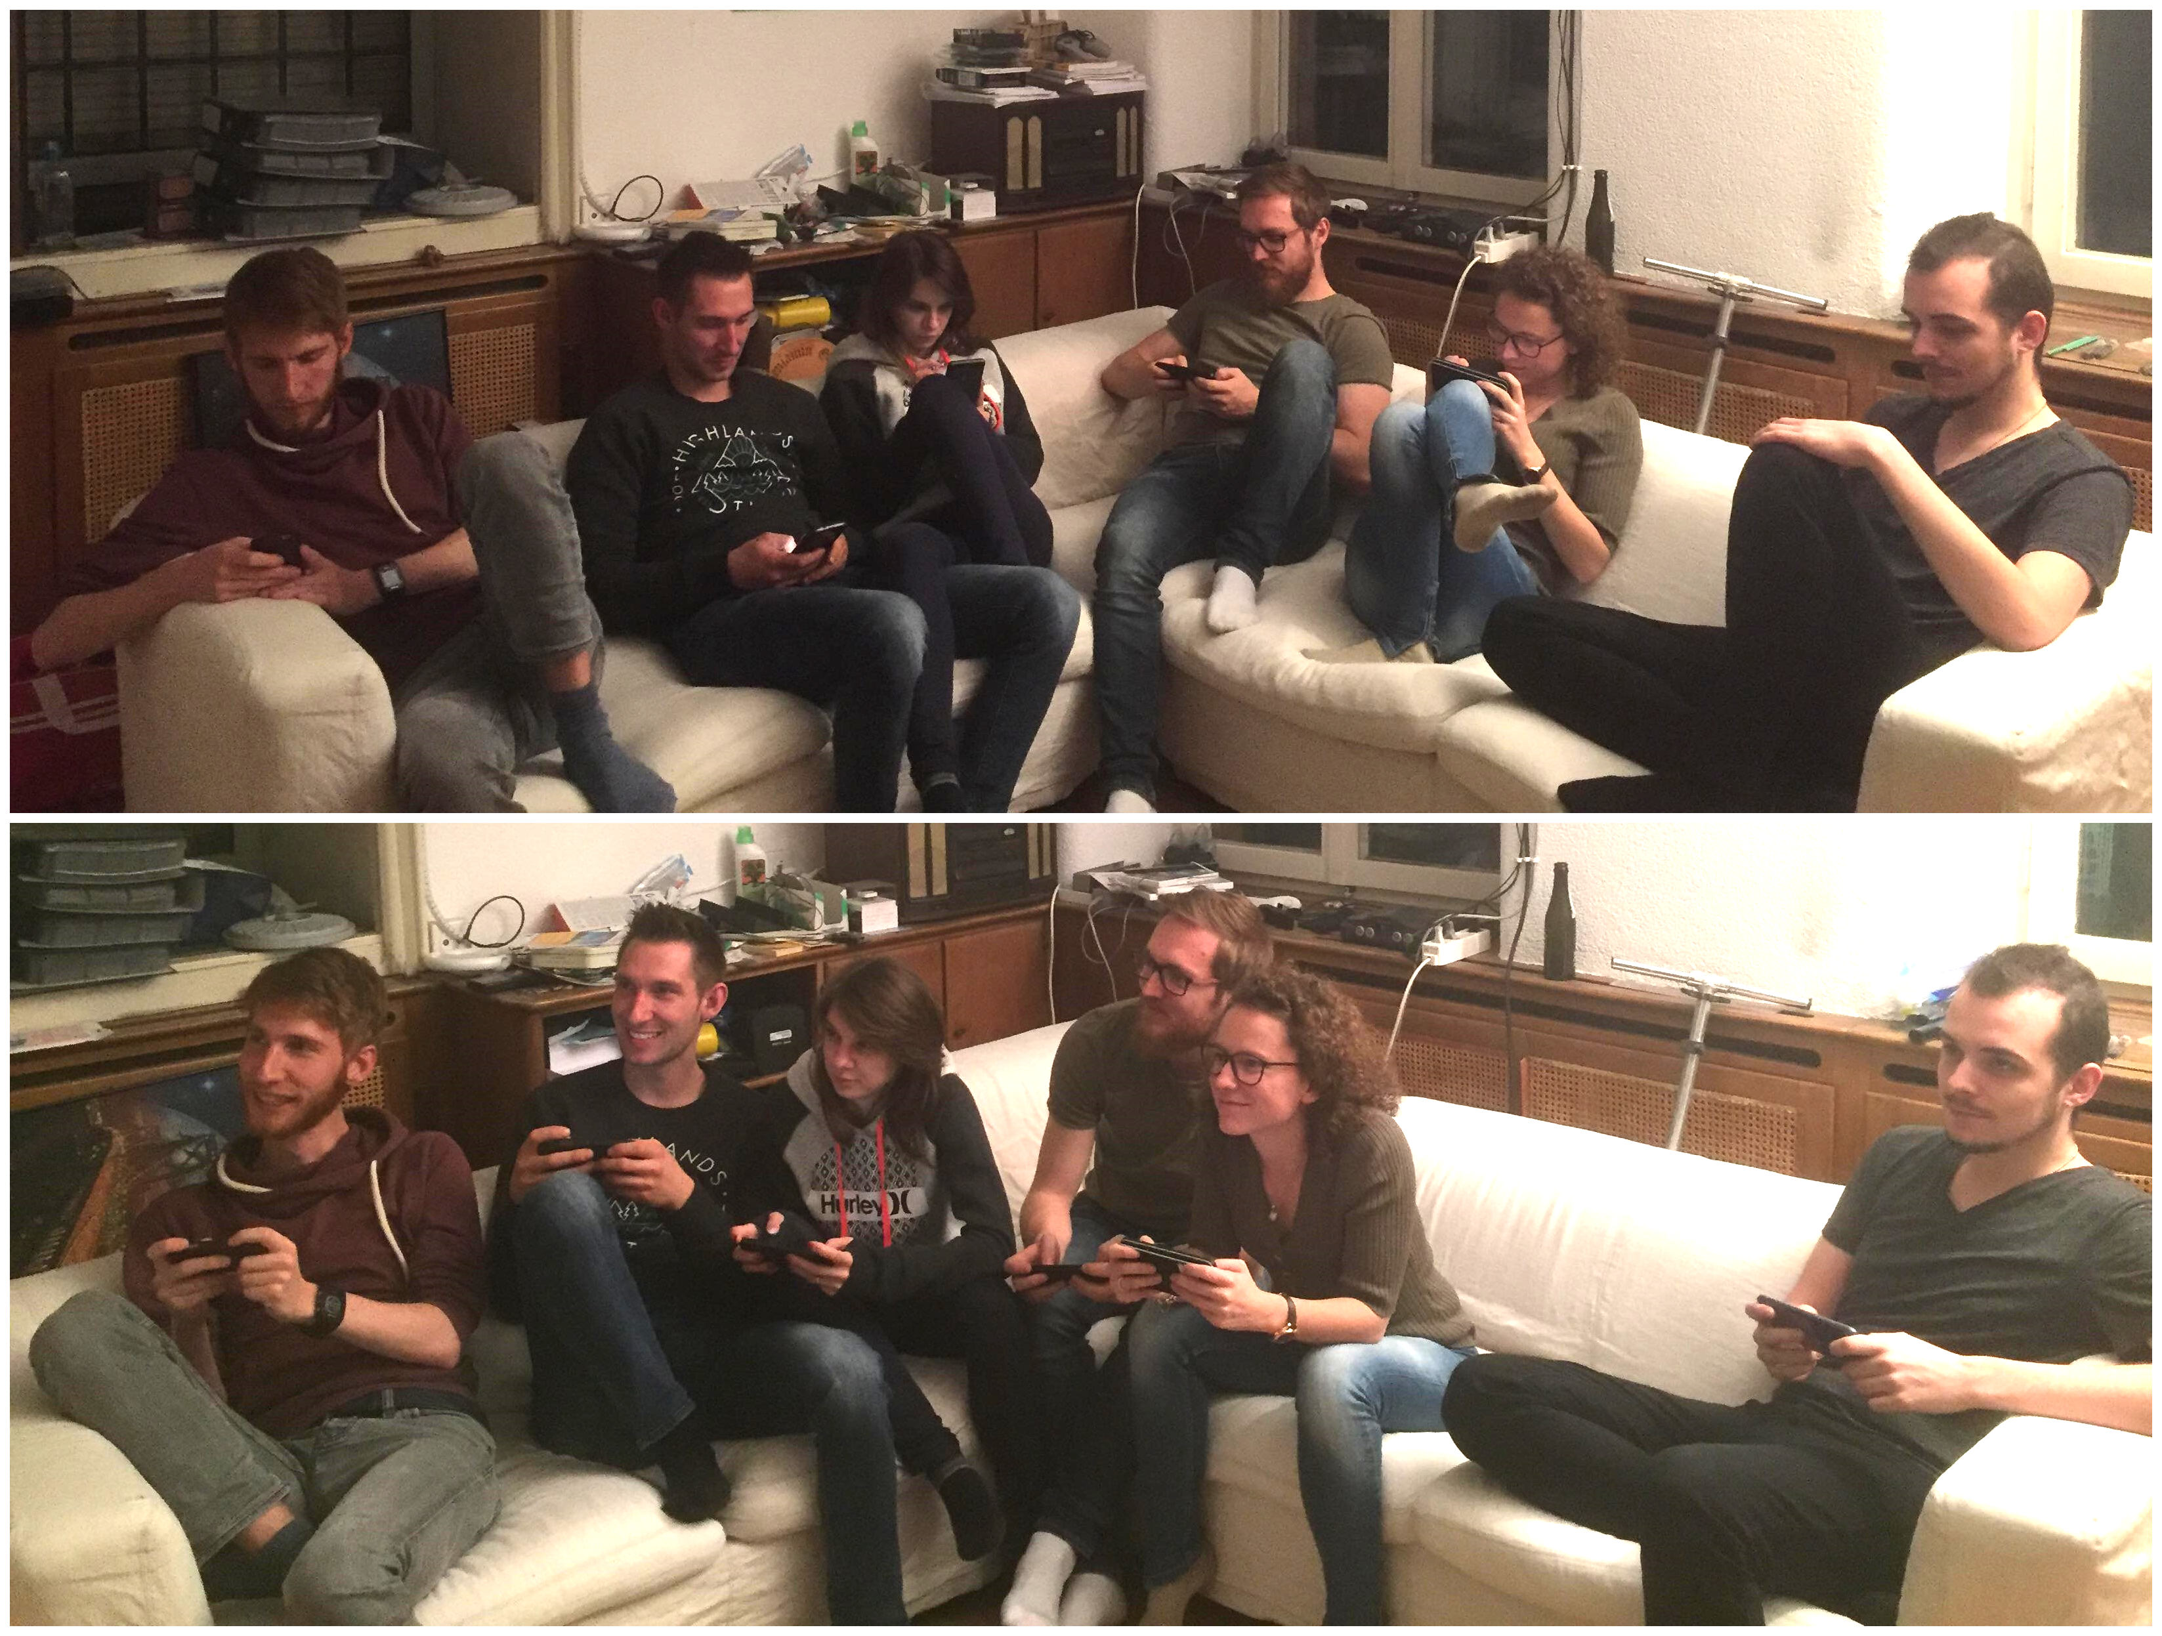
Example of playing on their side and then Together
Notes:
I think those numbers don’t surprise anyone as very often we see on the streets, in buses, trains, pretty much everywhere, people playing on their smartphone.
Even though those games might be good, they tend to isolate people and make them play in their corner. But what if we would make them play together.

Slide 5
Table of content
Goals
Games
Controllers
Demo
Conclusion
Question(s)
Sources

Slide 6
Goals
Use smartphones as controller for video games played on computer
Multiplayer games
Generic platform
Notes:
But what where actually my goals ?
The main goal was to create a platform which would use smartphones as controllers and a computer screen as the palce where the game is playing.
It had to be multiplayer.
I wanted to make this platform generic to allow the possibility to implement more easily games for this software.

Slide 7
Games
Snake Game
1-4 players
Simple rules
Simple controller
Domino Game
2 players
Kind of a card game
Smarter controller
Notes:
Snake game: You play as a little snake whose goal is to eat apple to grow bigger, but be aware of the walls and snake tails. No look at controller.
Domino: You have dominos in your hand, cards with two values, and you need to empty your hand by placing them on the board in turn. Here the smartphone is at the core of the game, and you need to look at it during the game.

Slide 8
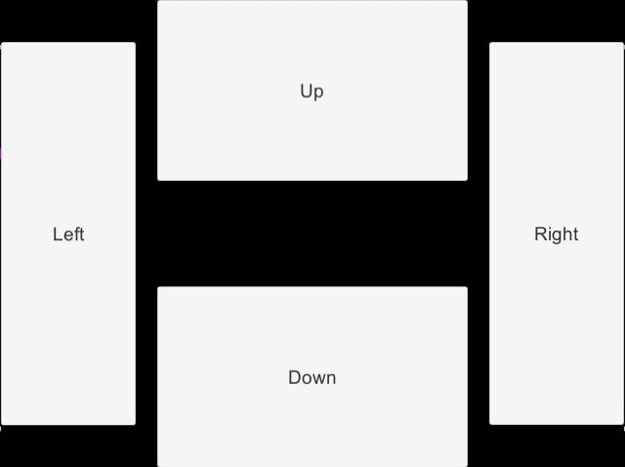
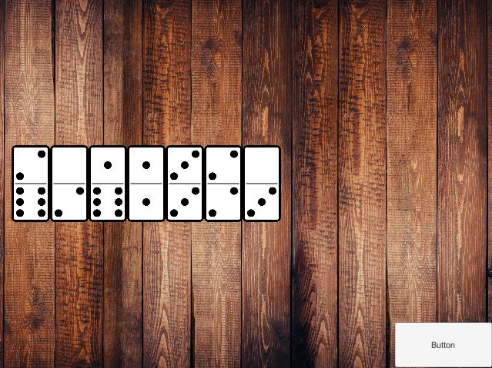
Controllers
Snake Controller
Domino Controller
Notes:
Here you can

Slide 9
Demo

Slide 10
Conclusion
Incredible amount of possibilities
Issues with older version of Android
Unity UNeT being deprecated
Notes:
The possibilities using a smartphone as a controller are huge, a game using the motion sensor of the phone could be developed, or the camera, speakers, or something less hardware oriented such as a monopoly.
Part of UI element are not rendered, even though they are interactable.
The network technology within unity, which is called UNeT, is being deprecated. (HLAPI & LLAPI) Thus the application will not work after unity 2018.4 and the genericity of the project can not be kept.

Slide 11
Question(s) ?
Notes:
Thank you for your time and attention

Slide 12
Sources
1. https://lpesports.com/e-sports-news/the-video-games-industry-is-bigger-than-hollywood

